Slide 1
Week Beginning 11.05.2020 – Yr 6

Slide 2
Hi all!
Hi everyone, hope you had a good week last week!
We have heard from lots of you which has been lovely – keep up the good work. This Powerpoint is the same layout as last week with literacy, maths, inquiry and active. As there was last week there is an option of ‘Hot chilli Maths’ in your shared files on Hwb. You will also be allocated a reading book on Abacus Active Learn, this will be updated weekly. The books can be found in ‘My Stuff’ under ‘Independent’. I have also uploaded a spelling game for you as well on abacus. Again this will be found in ‘My Stuff’.
Please can you have a look at your Hwb files, some of you have created lots and lots of files that need to be opened before I can access what you have been doing. Please delete these as it does add considerably to the time taken to look in your files – diolch! If I haven’t commented on your work yet I will try my best to do so.
We have included answers where we can but it wasn’t possible to include them for every activity. Discuss anything you are not sure about with your parents/siblings and of course ping us an email if you need any help finding anything (bygates@hwbcymru.net;price039@hwbcymru.net).
We will dip into your Hwb files as often as we can. Could you help us out by creating a ‘Home Learning’ folder so we can find your work (if you are completing it through Hwb). Some of you may choose to do it in your purple home learning book by hand – that’s fine too! Do not complete anything on this Powerpoint – please create a separate document on J2e.
We look forward to hearing from you!
Miss Bygate & Mr Price ☺

Slide 3
MONDAY
This Photo by Unknown Author is licensed under CC BY-SA-NC

Slide 4
MONDAY
Before starting the activities, talk together about what time capsules are and how you, as a family, can create your own based on your current situation. Explain that in the future, people will look back upon this period as a major event in our history. Remember to reassure everyone that this won’t last forever. Point out that your children will be telling their grandchildren about what it was like!
This Photo by Unknown Author is licensed under CC BY-SA-NC

Slide 5
MONDAY
Monday’s Task List
Read https://www.mykidstime.com/things-to-do/how-to-make-a-time-capsule-with-kids/ for information about time capsules
Create a label for your time capsule (like the one on this slide)
Draw yourself and your family.
Create a poster displaying ‘How I feel…’, ‘I am looking forward to…’ and ‘I am thankful for’.
Decorate your time capsule and add today’s work along with anything else you would like to add – ask your family!

Slide 6
Maths
Abacus game:
(Abacus game: Mastery Checkpoint 6.14.24
– solving problems & checking multiplication
problems.

Slide 7
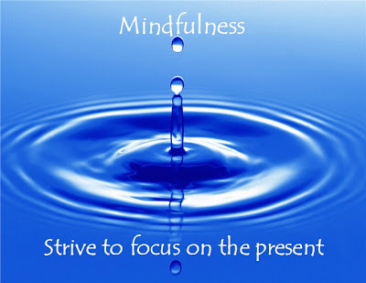
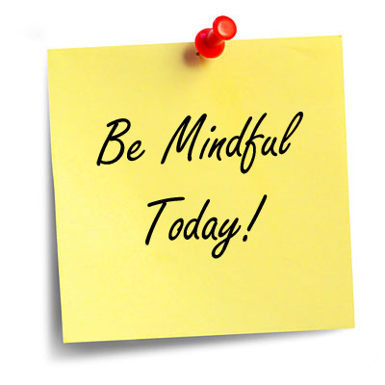
INQUIRY BASED LEARNING
What are the benefits of bringing mindfulness and meditation practice into a classroom setting?
Discussion Questions
What do you know about mindfulness and meditation as a healthful and beneficial practice?
How can mindfulness benefit us in terms of self-awareness?
How can it improve fundamental areas of our lives such as relationships and how we communicate?
How do you respond to the claims that some people make about meditation and mindfulness being a “fad” or “new-age nonsense?”
Why do you think it is that some educators have felt a need to bring an initiative based on mindfulness into their classrooms?
Have you or your students ever used meditation in the classroom before? Is it something you would be interested in doing?
Resources
What is mindfulness?
MindUP
Mindful Schools
Mindfulteachers.org
Upworthy: This school replaced detention with meditation. The results are stunning.
Integrating Mindfulness in Your Classroom Curriculum
https://www.youtube.com/watch?v=kO5I0p3IuiQ

Slide 8
TUESDAY

Slide 9
MONDAY
Tuesday’s Task List
Create a story map of a typical day in lock down. Include images, description and lots of colour! Think of it as a visual diary so that whoever finds the capsule will know what sorts of things you got up to!
Create a poster that has everyone in your household’s hand (or paw!) print on.
What other things have you decided to include? Today’s newspaper? A family photo?

Slide 10
Maths
Abacus game:
(Abacus game: FF 6.14c – Grand Totals)

Slide 11
INQUIRY BASED LEARNING
What are the benefits of bringing mindfulness and meditation practice into a classroom setting?
Discussion Questions
What do you know about mindfulness and meditation as a healthful and beneficial practice?
How can mindfulness benefit us in terms of self-awareness?
How can it improve fundamental areas of our lives such as relationships and how we communicate?
How do you respond to the claims that some people make about meditation and mindfulness being a “fad” or “new-age nonsense?”
Why do you think it is that some educators have felt a need to bring an initiative based on mindfulness into their classrooms?
Have you or your students ever used meditation in the classroom before? Is it something you would be interested in doing?
Resources
What is mindfulness?
MindUP
Mindful Schools
Mindfulteachers.org
Upworthy: This school replaced detention with meditation. The results are stunning.
Integrating Mindfulness in Your Classroom Curriculum
https://www.youtube.com/watch?v=kO5I0p3IuiQ

Slide 12
WEDNESDAY

Slide 13
MONDAY
Wednesday’s Task List
Write up a bit of a diary – you could include answers to the following questions:
How are you keeping in touch with your family and friends? (remember technology might look different in the future!)
Have things changed in your local area? How?
How are people helping others at this time? How are people helping people they don’t even know?
Challenge: Write a letter to yourself in the future or interview a family member and write a newspaper article about lockdown (example interview questions on the next slide).

Slide 14
MONDAY
Interview a family member or friend
How are you feeling?
How many days have you been at home?
How is home schooling going?
What has been the biggest change so far?
What are you excited to do once this is over?
What are you enjoying the most at home?
What are you grateful for?
Will you do anything differently once this is over?

Slide 15
Maths
Abacus game:
(Abacus game: PSI 6.14 Stunning Squares)

Slide 16
INQUIRY BASED LEARNING
What are the benefits of bringing mindfulness and meditation practice into a classroom setting?
Discussion Questions
What do you know about mindfulness and meditation as a healthful and beneficial practice?
How can mindfulness benefit us in terms of self-awareness?
How can it improve fundamental areas of our lives such as relationships and how we communicate?
How do you respond to the claims that some people make about meditation and mindfulness being a “fad” or “new-age nonsense?”
Why do you think it is that some educators have felt a need to bring an initiative based on mindfulness into their classrooms?
Have you or your students ever used meditation in the classroom before? Is it something you would be interested in doing?
Resources
What is mindfulness?
MindUP
Mindful Schools
Mindfulteachers.org
Upworthy: This school replaced detention with meditation. The results are stunning.
Integrating Mindfulness in Your Classroom Curriculum
https://www.youtube.com/watch?v=kO5I0p3IuiQ

Slide 17
THURSDAY

Slide 18
Literacy: Spelling → ‘Shun’ words.
See the next slide and complete the spelling exercise.
If you wish! Use coloured pencils/pens/paints/straws/anything you can find to spell the words in this key concept!
Use a dictionary to help you!!
“Did I get them right?” Answers are at the end of the Powerpoint – no peeking!
Pob lwc!

Slide 19
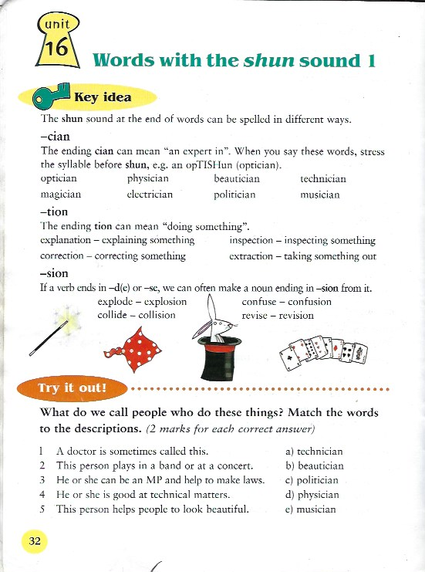
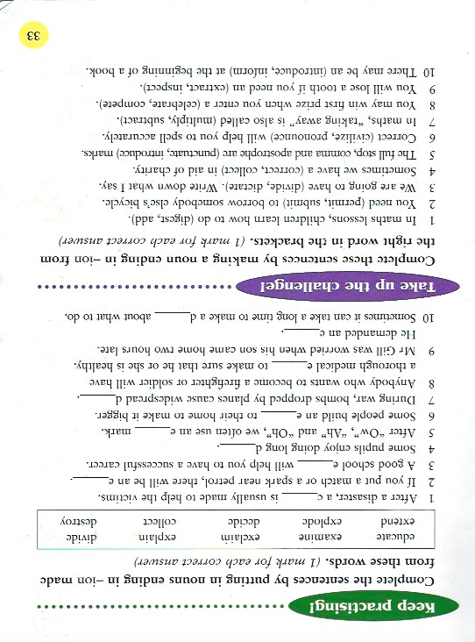

Slide 20
Maths
Abacus game:
(Abacus game: Diamond demolitions a/b/c)

Slide 21
INQUIRY BASED LEARNING
What are the benefits of bringing mindfulness and meditation practice into a classroom setting?
Discussion Questions
What do you know about mindfulness and meditation as a healthful and beneficial practice?
How can mindfulness benefit us in terms of self-awareness?
How can it improve fundamental areas of our lives such as relationships and how we communicate?
How do you respond to the claims that some people make about meditation and mindfulness being a “fad” or “new-age nonsense?”
Why do you think it is that some educators have felt a need to bring an initiative based on mindfulness into their classrooms?
Have you or your students ever used meditation in the classroom before? Is it something you would be interested in doing?
Resources
What is mindfulness?
MindUP
Mindful Schools
Mindfulteachers.org
Upworthy: This school replaced detention with meditation. The results are stunning.
Integrating Mindfulness in Your Classroom Curriculum
https://www.youtube.com/watch?v=kO5I0p3IuiQ

Slide 22
FRIDYAY!

Slide 23
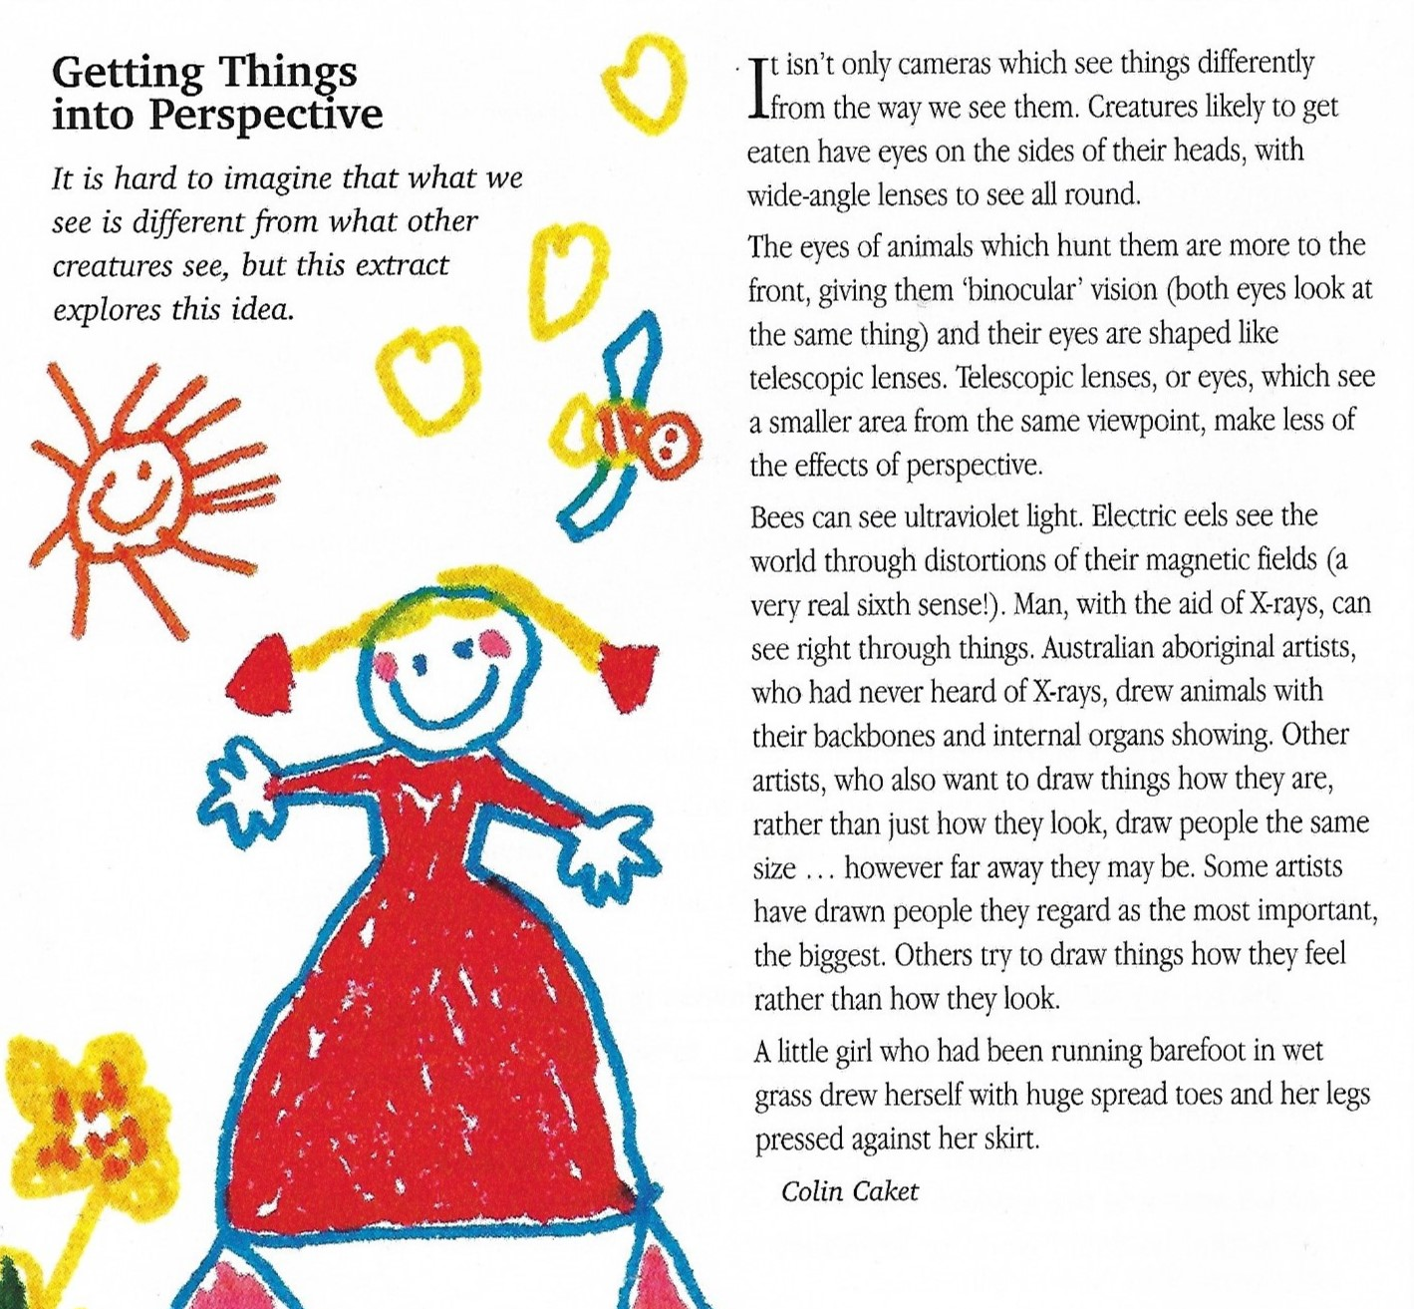
Literacy: Reading Comprehension Questions on next slide!

Slide 24
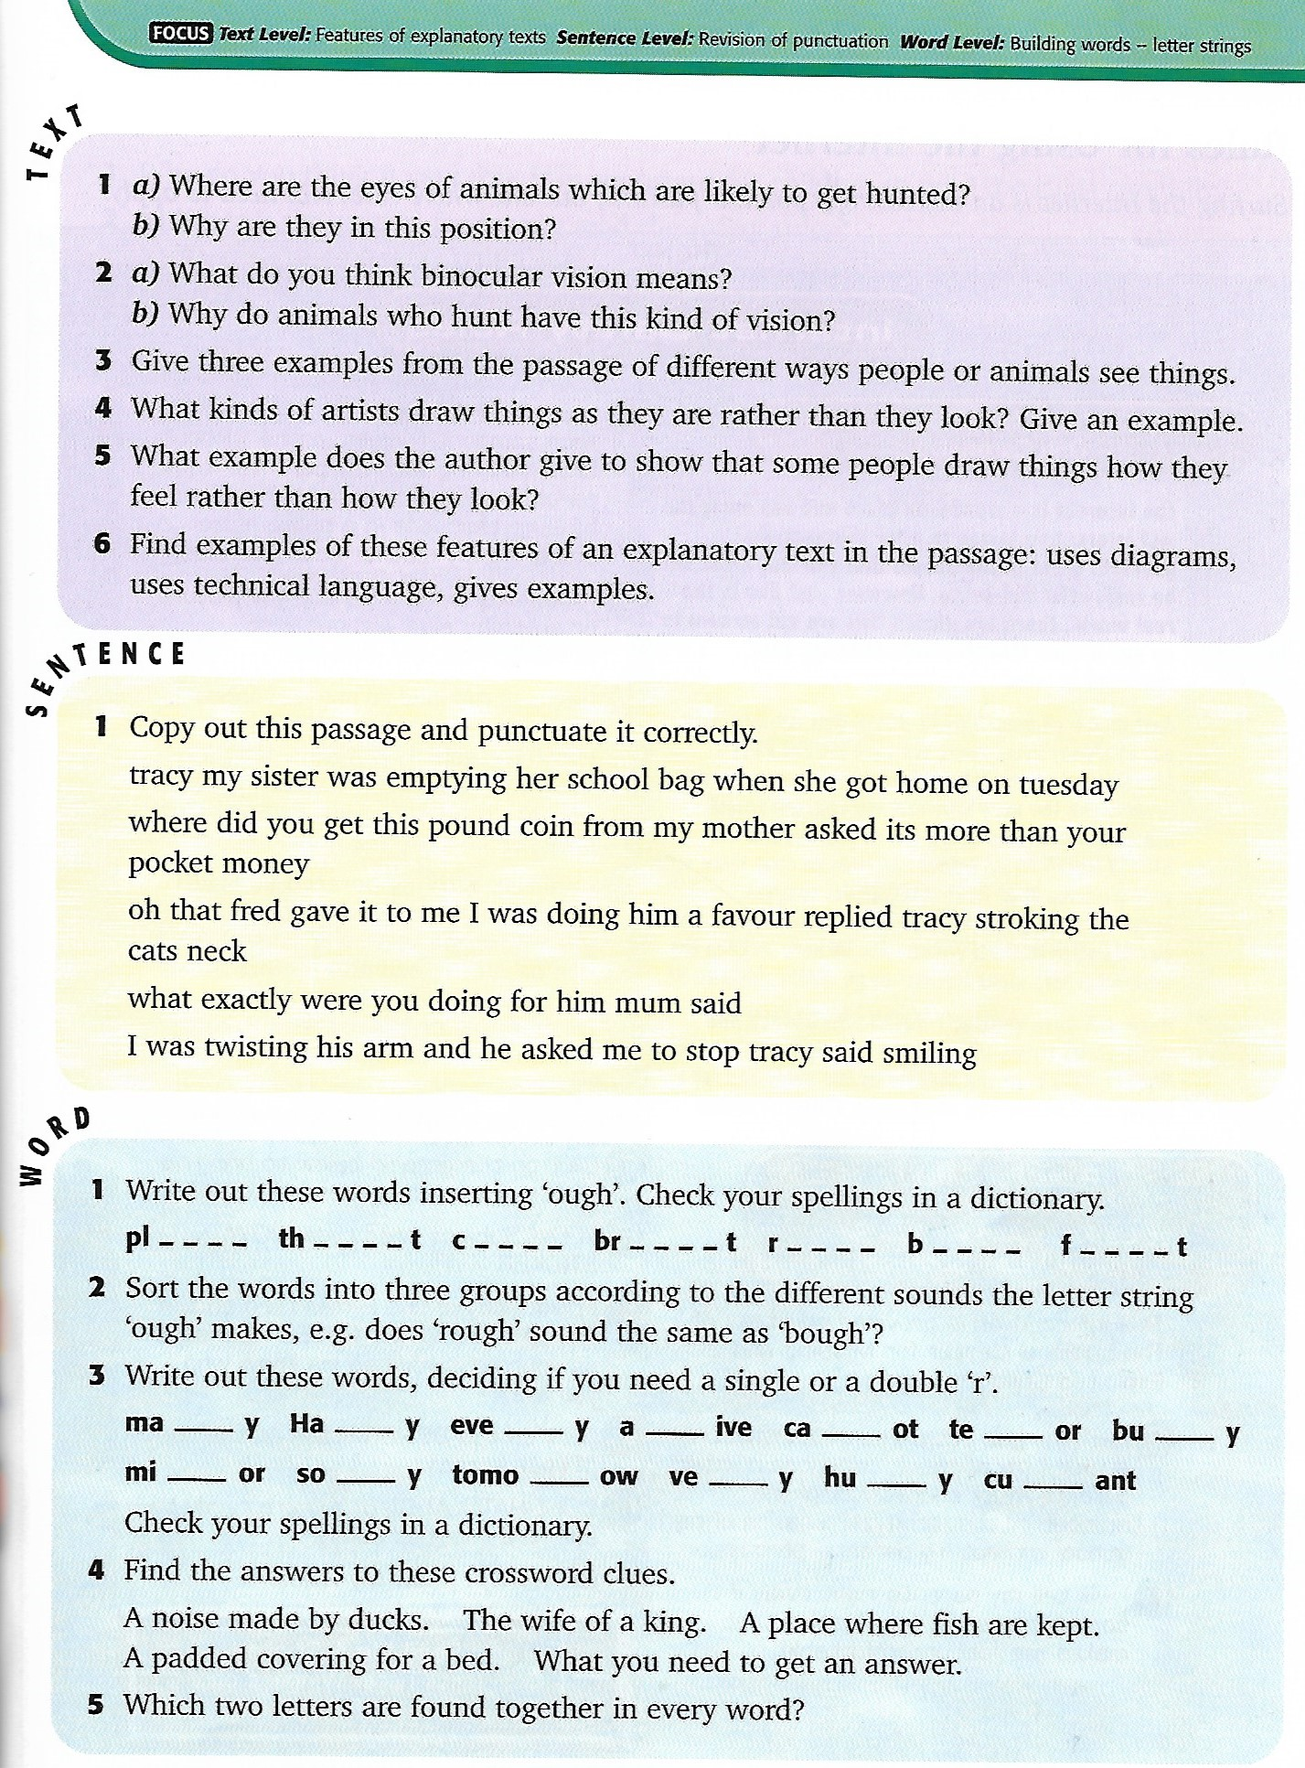

Slide 25
Maths
See J2e shared files – w/b 11th May 2020
Day Trips Maths
Answers are on the final page or the document – try not to peep!

Slide 26
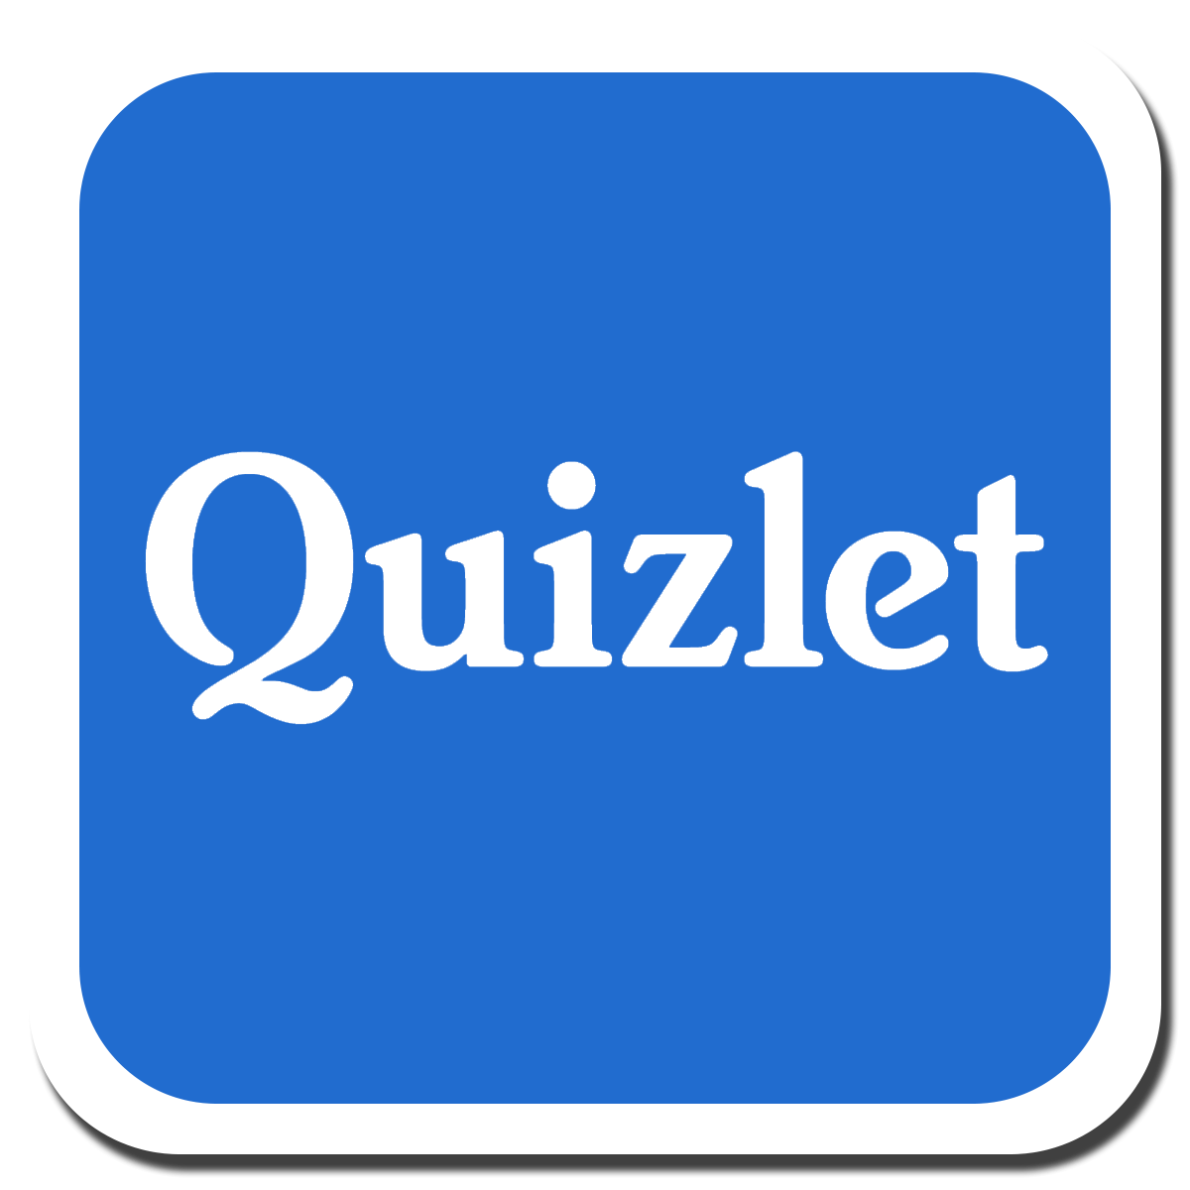
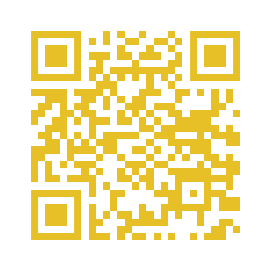

Slide 27
INQUIRY BASED LEARNING
What are the benefits of bringing mindfulness and meditation practice into a classroom setting?
Discussion Questions
What do you know about mindfulness and meditation as a healthful and beneficial practice?
How can mindfulness benefit us in terms of self-awareness?
How can it improve fundamental areas of our lives such as relationships and how we communicate?
How do you respond to the claims that some people make about meditation and mindfulness being a “fad” or “new-age nonsense?”
Why do you think it is that some educators have felt a need to bring an initiative based on mindfulness into their classrooms?
Have you or your students ever used meditation in the classroom before? Is it something you would be interested in doing?
Resources
What is mindfulness?
MindUP
Mindful Schools
Mindfulteachers.org
Upworthy: This school replaced detention with meditation. The results are stunning.
Integrating Mindfulness in Your Classroom Curriculum
https://www.youtube.com/watch?v=kO5I0p3IuiQ

Slide 28
ANSWERS

Slide 33
Spellings

